Slide 1
Education Bot
Ong Xian Hao Jordan [154358G]

Slide 2
Objectives
To research and develop an Education Bot
To implement motor controls
To implement Facial and Speech detection

Slide 3
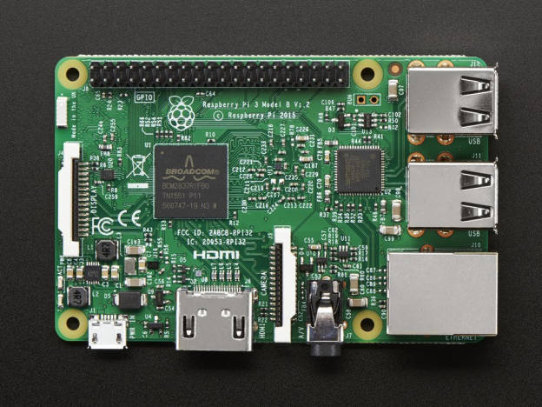
Robot Components
Raspberry Pi
Motors
Camera
Microphone

Slide 4
Gantt Chart
S/No | Weeks Activity | 1-2 | 3-4 | 5-6 | 7-8 | 9-10 | 11-12
1 | Research on various components
2 | GUI building
3 | Motor Setup
4 | Implementing Face Detection
5 | Implementing Speech Recognition
6 | Testing

Slide 5


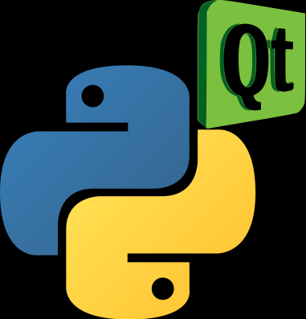
Interface
Selecting a GUI
Learning how to make GUIs
Notes:
Table for prefences

Slide 6
 | TKinter | wxPython | PyQt
Supported Versions | Python 2 and 3 | Python 2 | Python 2 and 3
Installation | Already inbuilt | Not inbuilt | Not inbuilt
Stability | Stable | Unstable | Stable
Designing an Application | Difficult to make a huge application | Easy to build with wxFormBuilder | Easy to build with QtDesigner
Notes:
Table for prefences

Slide 7
PyQt
Advantages
Very simple to design a GUI with QtDesigner
Very easy to move the code to other platforms
Disadvantages
Assigning functions to widgets was tricky
Notes:
Table for prefences

Slide 8
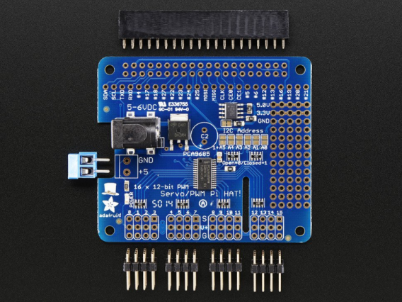
Motor
The motors are powered and controlled by the motor HATs
The pi will send signals to the HAT using i2c
Notes:
Comparison and recommdenation

Slide 9

Notes:
Comparison and recommdenation

Slide 10
Motor
The motors movement are bind into the WASD and Q keys.
Controls
W | Forward
A | Left
S | Reverse
D | Right
Q | Stop
Notes:
Comparison and recommdenation

Slide 11

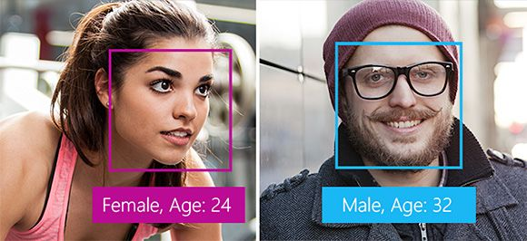
Face Recognition
Microsoft Cognitive Services provides the Face Recognition API
Aside from detecting faces in images, other functions include identifying, and verifying faces.

Slide 12
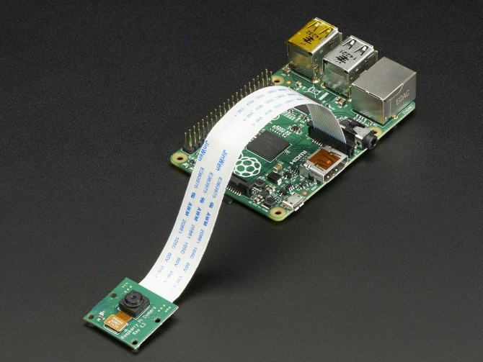
Face Recognition
The Pi camera takes the photo for facial recognition
It attaches via a 15cm ribbon cable to the CSI port on the Raspberry Pi and it is able to record videos and capture still images.

Slide 13
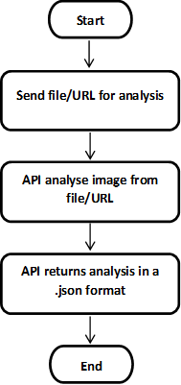
Face Recognition

Slide 14


Speech Recognition
Google Cloud provides the Speech Recognition API
Its speech recognition is based on the Google app on android phone and have keyword recognition.

Slide 15
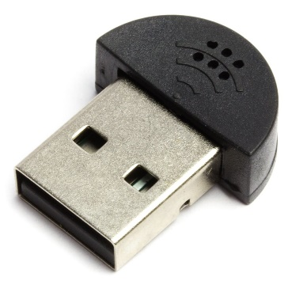
Speech Recognition
The audio will be recorded on to a USB microphone plugged into the Raspberry Pi USB port.
It records on 44100 sample rate and adjusts dynamic energy based on ambient volume

Slide 16
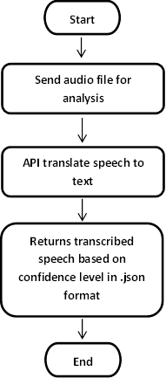
Speech Recognition

